Slide 1
Just Getting Started… Digitization and Long-term Preservation of Audiovisual Records in the Archives of Social Democracy (AdsD) No Time to Wait 4 (Budapest, 2019-12-05)
Alexander Boix

Slide 2
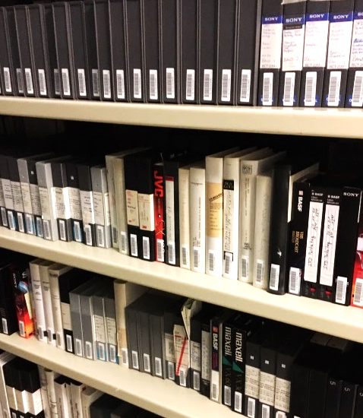
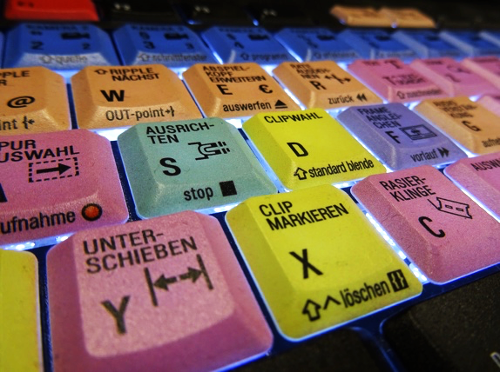
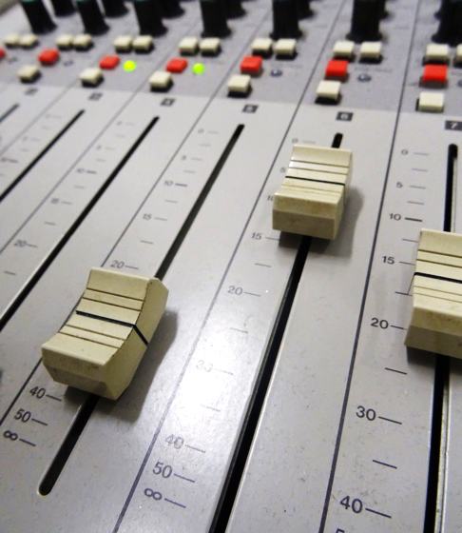
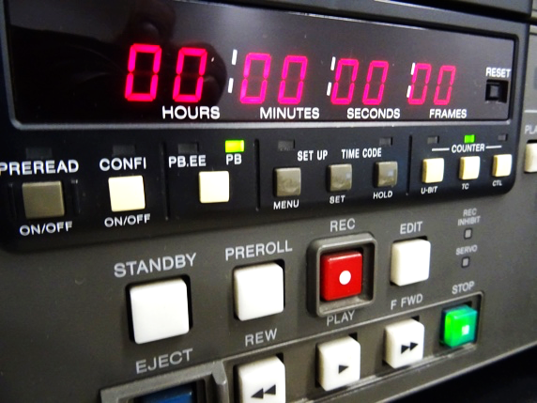
Agenda
Introduction
Workflow
Perspective
Just Getting Started…
No Time to Wait 4 (Budapest, 2019-12-05)

Slide 3
Introduction
Archiv der sozialen Demokratie der Friedrich-Ebert-Stiftung
audio visual collection contains:
ca. 25.000 video objects
ca. 20.000 film Objects
ca. 10.000 audio Objects
2017 - 2019 comprehensive evaluation of the collection and the associated work processes
since 2019
step-by-step implementation of new work processes considering recommendations of e.g. IASA, FADGI, Memoriav and nestor
Just Getting Started…
No Time to Wait 4 (Budapest, 2019-12-05)

Slide 4
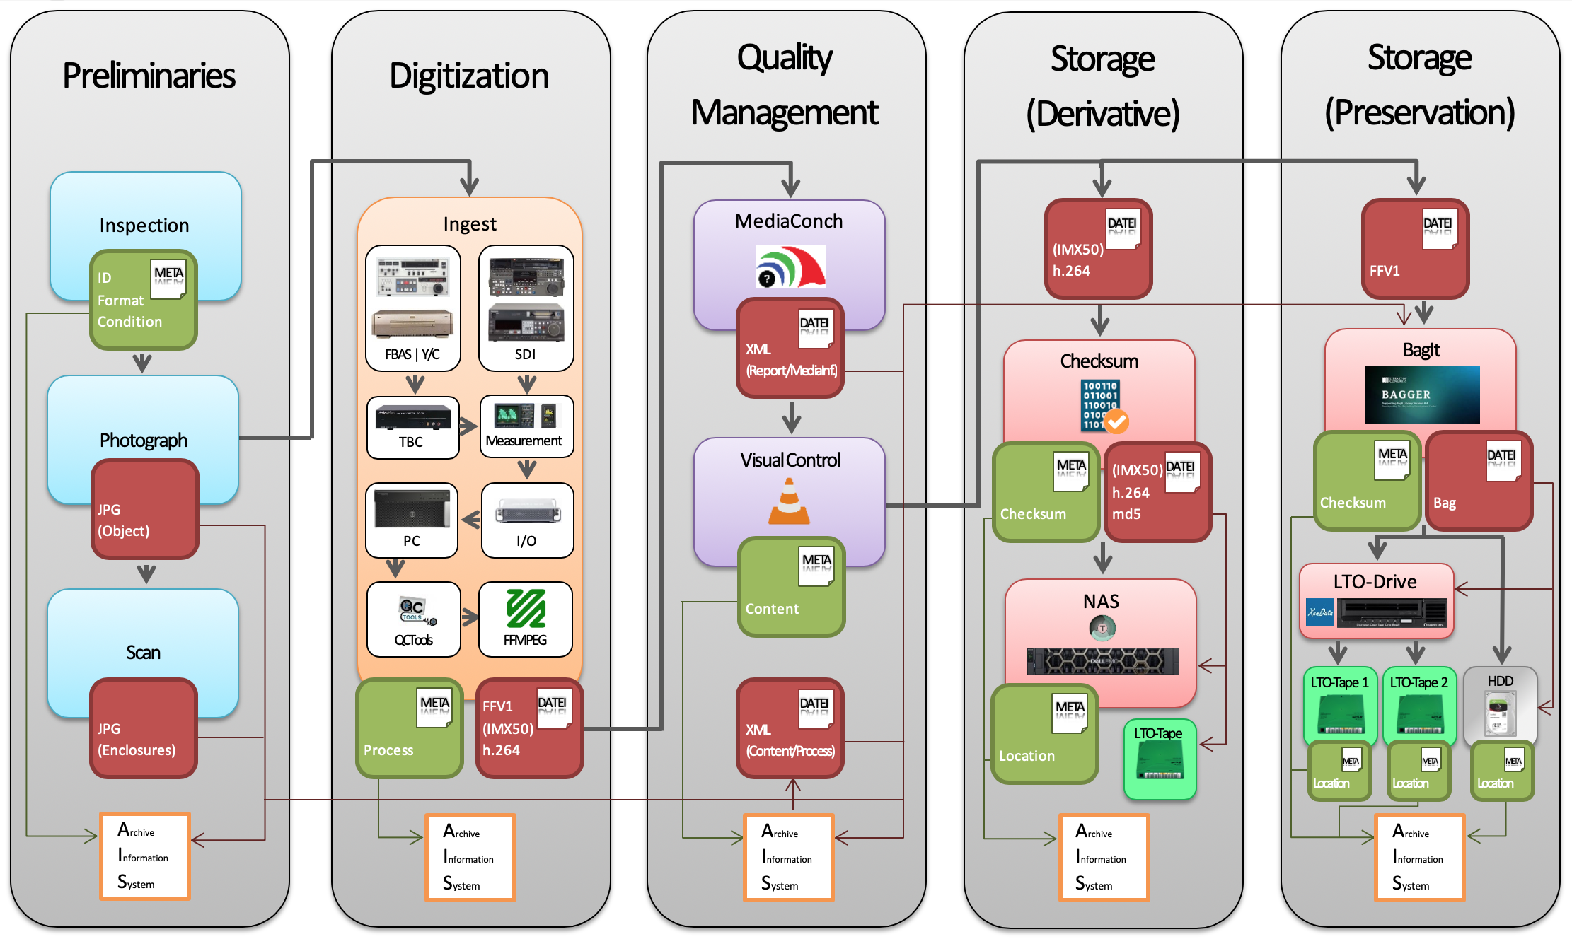
Workflow
Just Getting Started…
No Time to Wait 4 (Budapest, 2019-12-05)

Slide 5
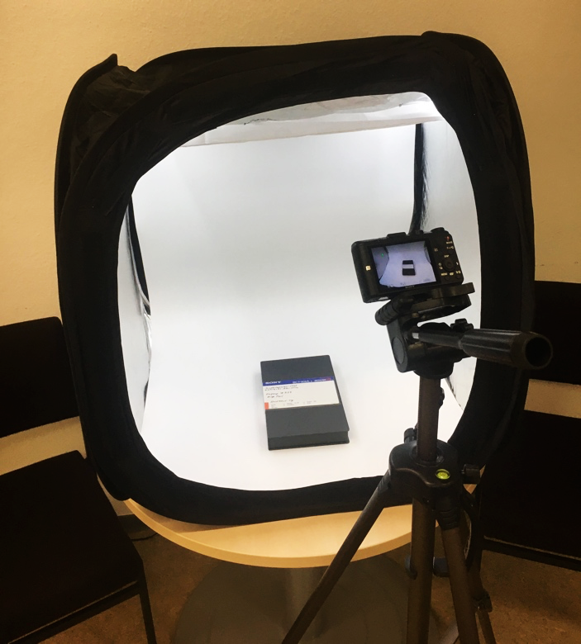
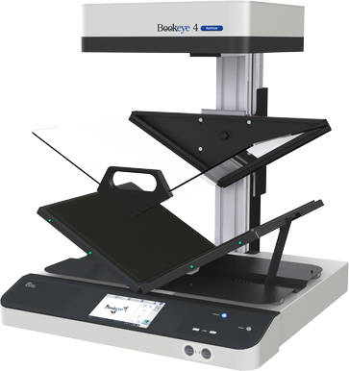
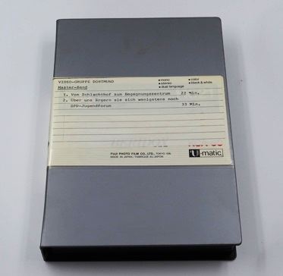
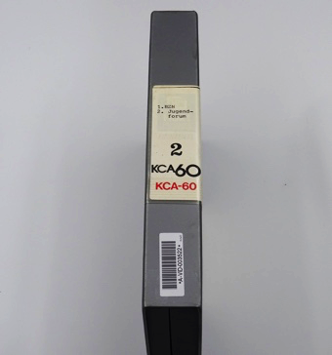
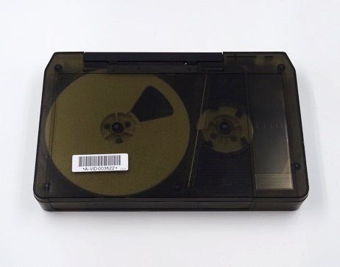
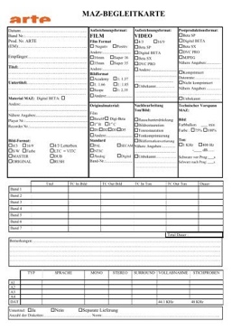
Workflow
Just Getting Started…
No Time to Wait 4 (Budapest, 2019-12-05)

Slide 6
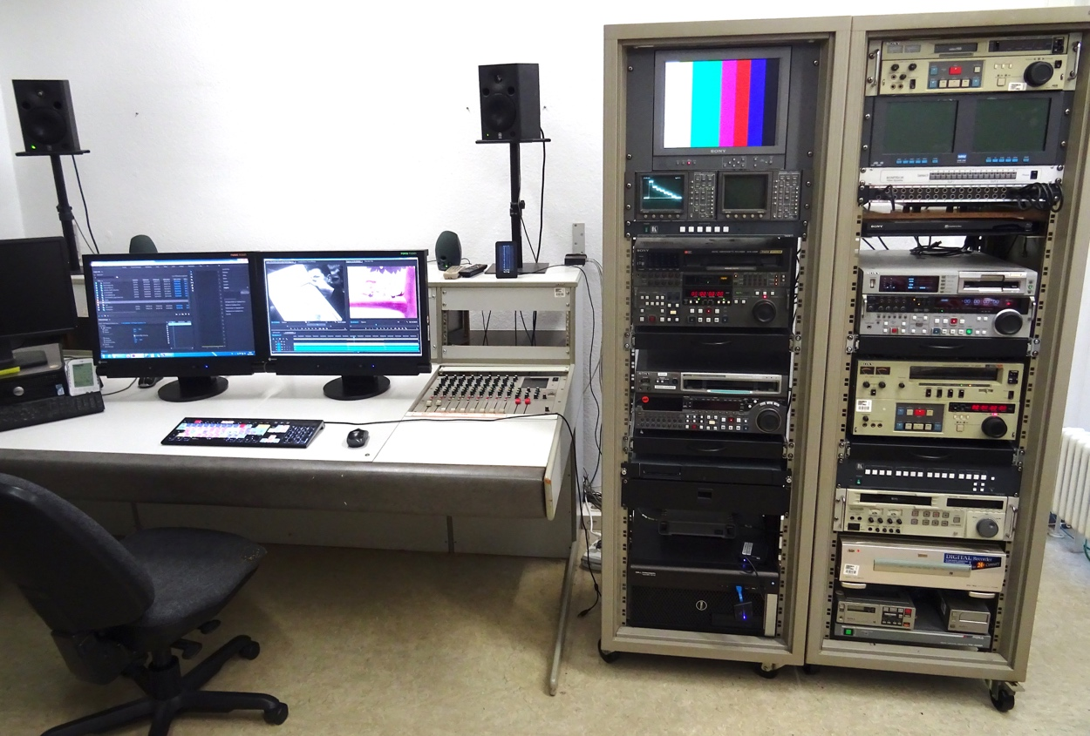
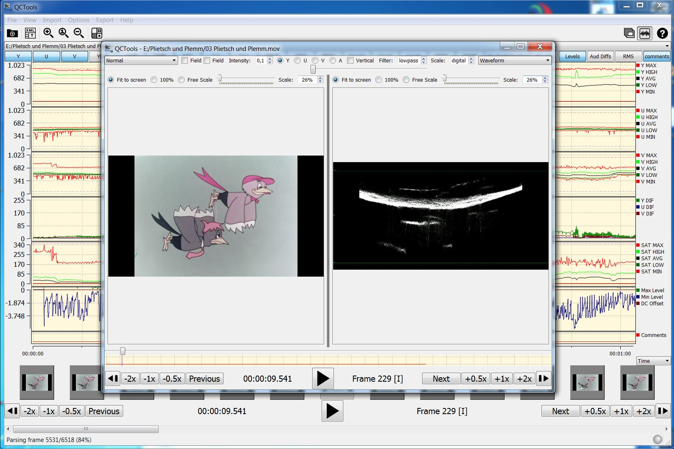
Workflow
QCTools
QCTools
Just Getting Started…
No Time to Wait 4 (Budapest, 2019-12-05)

Slide 7
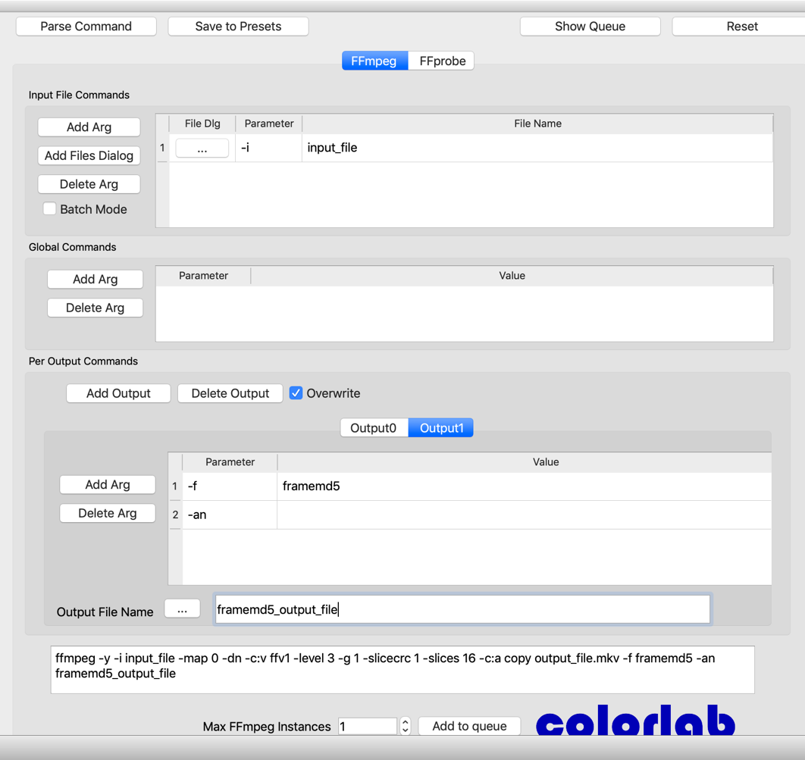
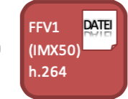
Workflow
ffmprovisr
https://amiaopensource.github.io/ffmprovisr/
FFmpeg Cookbook for Archivists https://avpres.net/FFmpeg/
QCTools
FFCommand
FFMPEG
QCTools
Just Getting Started…
No Time to Wait 4 (Budapest, 2019-12-05)

Slide 8
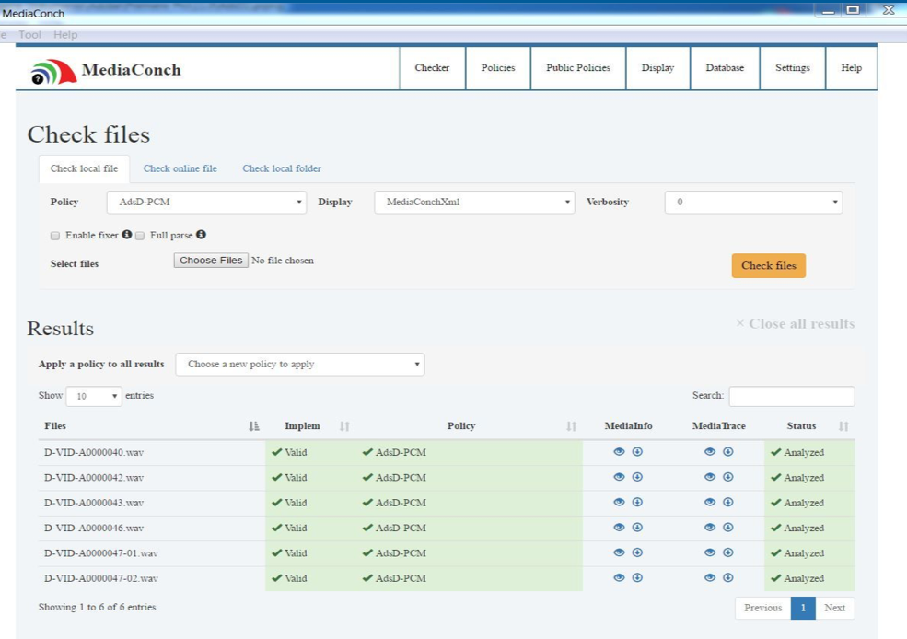
Workflow
MediaConch
MediaConch
Just Getting Started…
No Time to Wait 4 (Budapest, 2019-12-05)

Slide 9
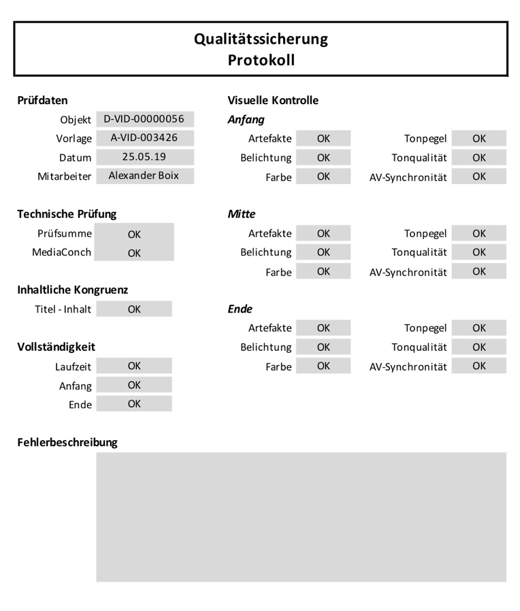
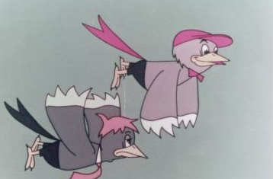
Workflow
Protocol
Visual Control
Just Getting Started…
No Time to Wait 4 (Budapest, 2019-12-05)

Slide 10
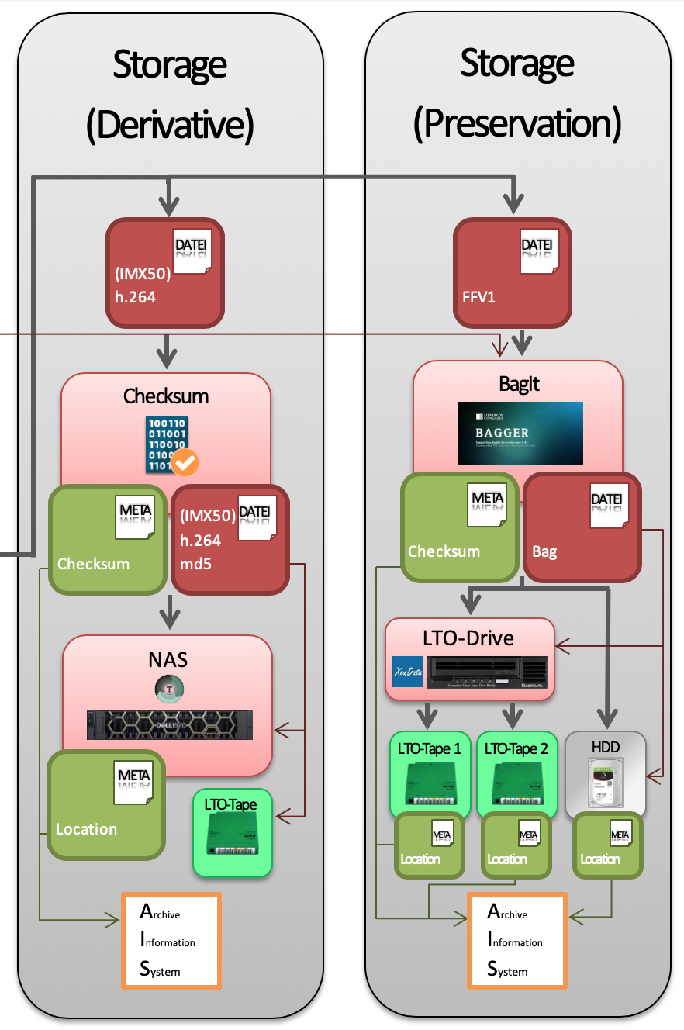
Workflow
Just Getting Started…
No Time to Wait 4 (Budapest, 2019-12-05)

Slide 11
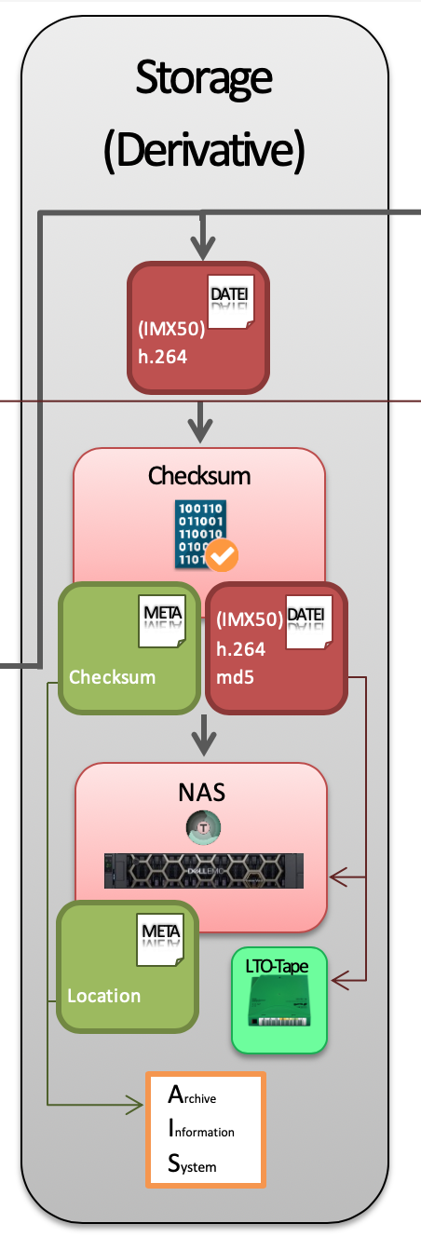
Workflow
Just Getting Started…
No Time to Wait 4 (Budapest, 2019-12-05)

Slide 12
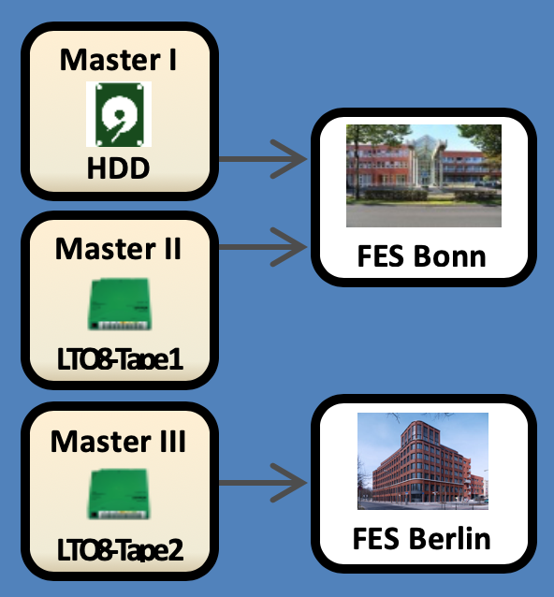
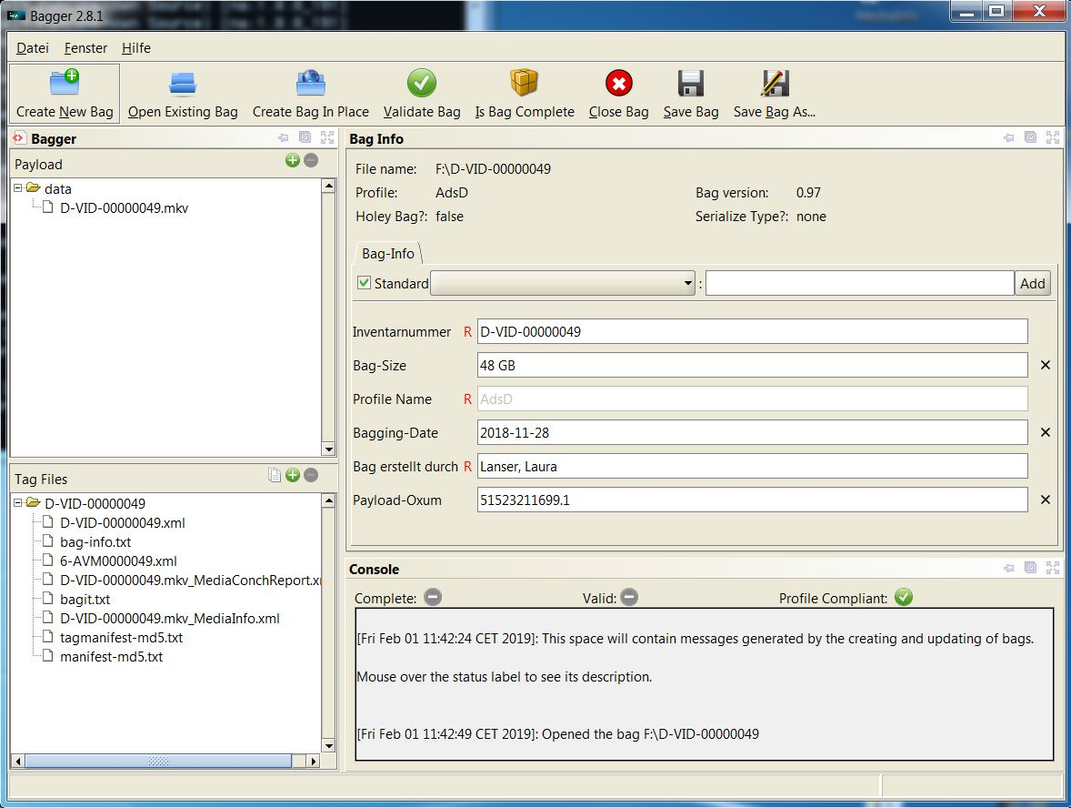
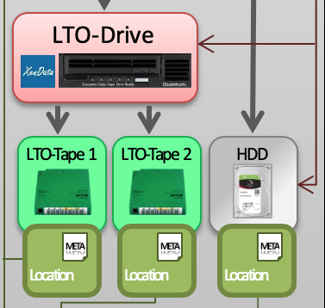
Workflow
XML MediaInfo
XML (DC) Content
XML Digital Item
FILE
FILE
FILE
3, 2, 1…
3 copies
2 different storage media
1 copy at a different location
JPG (Object)
JPG (Enclosures)
FILE
FILE
Just Getting Started…
No Time to Wait 4 (Budapest, 2019-12-05)

Slide 13
Perspective
Questions?
alexander.boix@fes.de
Just Getting Started…
No Time to Wait 4 (Budapest, 2019-12-05)

Slide 14
Perspective
Questions?
alexander.boix@fes.de
Just Getting Started…
No Time to Wait 4 (Budapest, 2019-12-05)

Slide 15
Perspective
Questions?
alexander.boix@fes.de
Just Getting Started…
No Time to Wait 4 (Budapest, 2019-12-05)

